Slide 1
amazon sales analysis
Kunal Kedari

Slide 2
introduction
In today's digital world, Amazon is the big player in online shopping. Sales management has gained importance to meet increasing competition and the need for improved methods of distribution to reduce cost and to increase profits.
Sales management is super important now because there's so much competition, and businesses want better ways to sell stuff and make more money. Our study looks into this

Slide 3
Use Cases
Sale trends month wise, year wise, yearly-month wise.
Total revenue.
Revenue per country.
Top & Bottom 5 country’s contributing to the sales.
Which year had the most sales?
Total profit & Total cost.
Highest selling item type
Which channel is contributing to maximum sales.

Slide 4
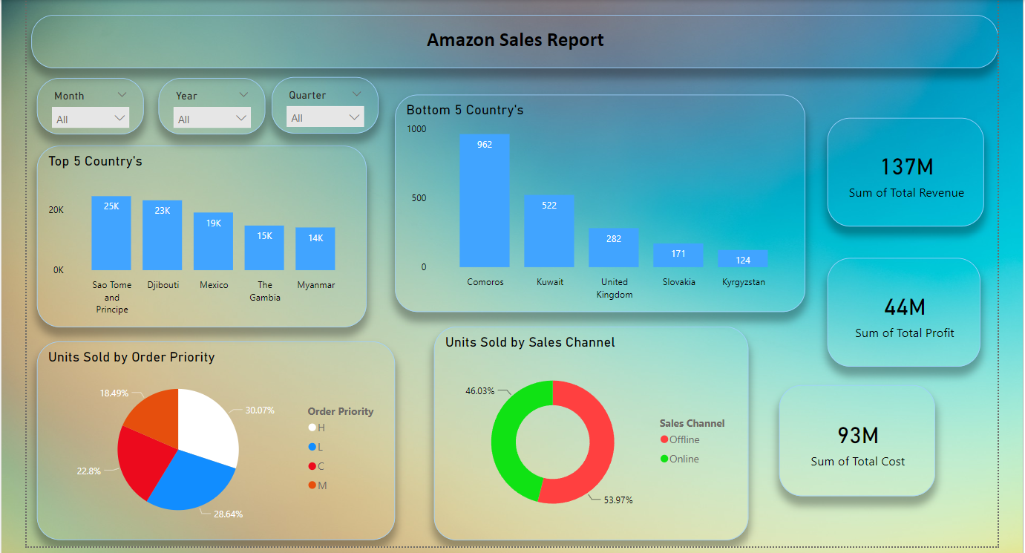
My designs

Slide 5
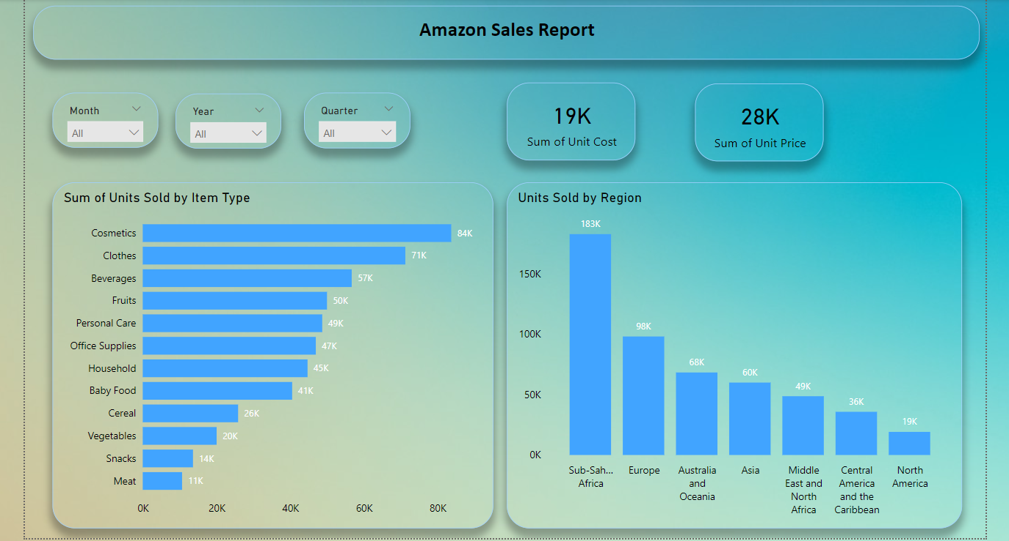

Slide 6
insights
The overall revenue is $137 million.
The highest units sold through the offline channel. & Cosmetics are in highest demand, followed by clothes.
Sub-Saharan Africa is a high unit sales region.
São Tomé and Príncipe, Djibouti, Mexico, The Gambia, and Myanmar are the top five countries with the highest sales.
In 2012, "L" had the highest revenue priority order at 55.7%, totaling $32 million. Additionally Personal care units had the highest sales through the online channel.
In 2011, revenue was the lowest, with a "C" priority order at 48.31%. The units sold were primarily through the offline channel.

Slide 7
CONCLUSION
From 2010 to 2017, the Comoros, Kuwait, the United Kingdom, Slovakia, and Kyrgyzstan consistently had low sales. Therefore, we should focus on these countries by introducing new products, sending targeted emails, and showcasing ads, offers, or coupons.

Slide 8
THANK YOU
Kunal Kedari
kunalkedari626@gmail.com

